Slide 1
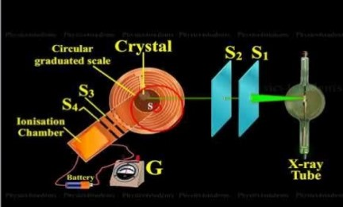
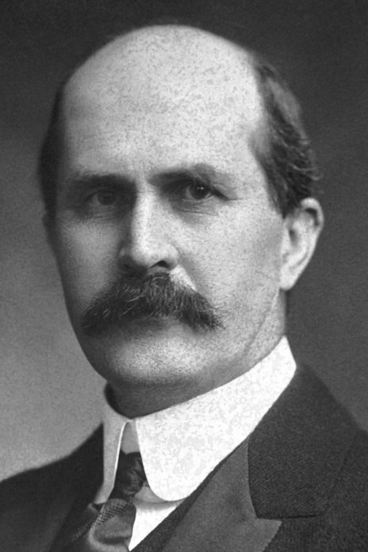
BPM: 2 Engineering Physics-II
UNIT –I: Crystal Structures and X-ray Diffraction
Lecture-8
By- Prof. B. K. Pandey, Dept. of Physics and Material Science
Sir William Henry Bragg The Nobel Prize in Physics 1915

Slide 2
COMPTON EFFECT
Compton effect gives direct and conclusive evidence in support of the particle nature of electromagnetic radiations.
When a monochromatic beam of X-rays (or the electromagnetic radiations of short wavelength) of wavelength λ is allowed to incident on scattering material, the scattered beam contains radiations of longer wavelength λ′ in addition to the radiations of incident wavelength λ.
The difference between λ′ and λ, i.e., λ′ – λ, is known as Compton shift, and this effect is called Compton effect.

Slide 3

EXPRESSION FOR COMPTON SHIFT
In 1985 Professor Wilhelm Condrad Röntgen found some highly penetrating radiations named as X-rays.
X-Rays are electromagnetic rays having shorter wavelength lying in the range from 0.01 Å to 10 Å.

Slide 4

EXPRESSION FOR COMPTON SHIFT
In order to derive an expression for change in wavelength of the scattered X-rays, Compton made some basic assumptions as given below:
(i) Incident X-rays or electromagnetic radiations consist of photons of same energy, i.e.,
E = hν
Momentum (P) of electron can be calculated from the relativistic energy expression,
where m₀ is the rest mass of the particle. Since the rest mass of photon is zero, hence the above expression becomes
E = Pc

Slide 5
(ii) Scattered electrons are treated as free particles because the energy of X- ray photons is very large (~ 10 keV) as compared to the binding energy of the electrons in the atom.
(iii) The electrons of the scattering material are treated as at rest, because the energy of incident X-ray photons is very high as compared to that of electrons in atoms.
(iv) Collisions between incident X-ray photons and free electrons are perfectly elastic. There is no loss of energy and momentum during their collision, and hence the laws of conservation of energy and momentum hold good.

Slide 6
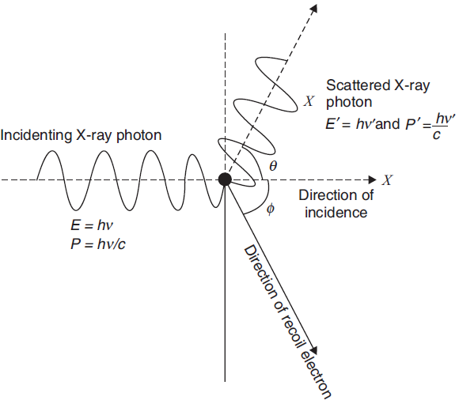
Scattering of X-ray photon with the electron of scattering material

Slide 7
When an X-ray photon of energy hν and momentum hν/c collides elastically with a target electron of rest mass m₀, it transfers some of its energy to the electron so that its frequency reduces to ν′.
Let us also consider that target electron recoils at angle Φ with momentum mν and energy mc², while scattered photon makes angle θ with the direction of incidence.
Now, according to the principle of law of conservation of energy
From the principle of conservation of momentum, we have
Momentum before the collision = Momentum after the collision

Slide 8




Now, applying the principle of conservation of momentum in the direction of incidence, we get
We know that
By the above equations we get
Or,
It is the expression for the Crompton shift Δλ.

Slide 9

DISCUSSION ON COMPTON EFFECT
Compton shift can be discussed under the following points:
(i) From the expression of Compton shift , it is clear that the increase in wavelength or the Compton shift (Δλ) is independent of the wavelength of the incident radiation as well as the nature of the scattering material. It depends only on the angle of scattering,θ.
(ii) The constant h/m₀c has dimensions of length and is called the Compton wavelength (λc) of the target particle. For an electron, the Compton wavelength is

Slide 10
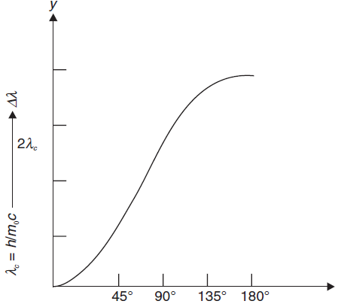
(iii) From Eq. (7.14), it is clear that Compton shift increases from 0 to 2λ_{c} for θ=0 to θ=π . If θ =π , then
=λ_{c} (1+1) = 2 λ_{c}
This indicates that a head-on collision between the incident photon and the target electron leads to the backscattering of the photon.
Variation of Δλ with scattering angle θ

Slide 11
EXPERIMENTAL VERIFICATION OF COMPTON EFFECT
The experimental arrangement used for observing Compton scattering is shown in Figure.
In this arrangement, X-ray tube is used as the source of X-rays. Collimated beam of monochromatic X-rays of wavelength 0.707A⁰ is allowed to be incident on the graphite target.
The intensity of the scattered X-rays is measured as a function of their wavelength for different angles of scattering.

Slide 12
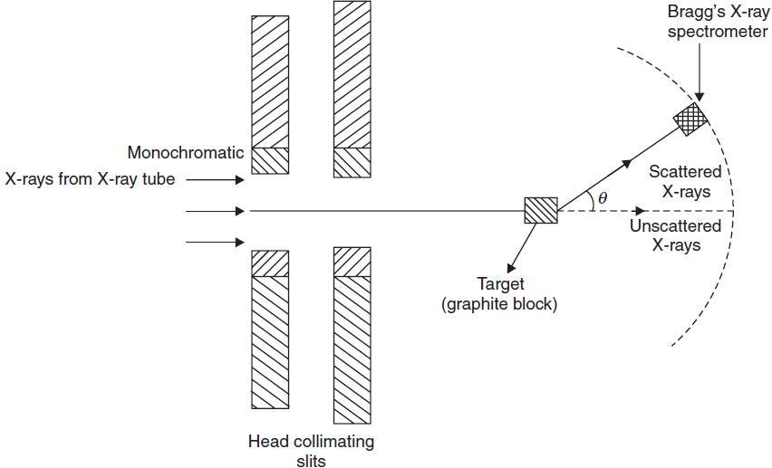
Experimental verification of Compton effect

Slide 13
On the basis of the variation of intensity with wavelength, we can draw the following conclusions:
(i) Compton shift increases with increase in scattering angle θ.
(ii) At θ= 0, there is a single peak which indicates that there is no Compton shift at θ= 0.
(iii) Spreading is observed in the wavelength of Compton shift due to the movement of electrons in the atom (i.e., due to the momentum distribution of electron).
(iv) For the same scattering angle, the intensity of unmodified peak is greater for heavier elements. It is due to this reason that most of the electrons are tightly bound in heavier atoms, whereas in light atoms electrons are relatively loosely bound.

Slide 14




DIRECTION OF RECOILED COMPTON ELECTRON
In order to determine the direction of recoiled electron, let us use Eqs.
and
From the above Eqs. we can write
We also know that
Hence
Above equation gives the direction of recoiled Compton electron.

Slide 15





KINETIC ENERGY OF RECOILED ELECTRON
To derive an expression for the kinetic energy of a recoiled electron, let us start with equation,
We know that
Where
The maximum value of kinetic energy of a recoiled electron (KE_{max}) can be given as

Slide 16
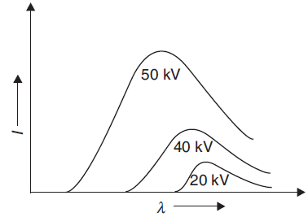
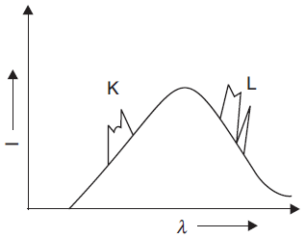
X-RAY SPECTRA
Continuous Spectra
Characteristic Spectra

Slide 17

Origin of characteristic X-ray spectra
When high velocity electrons penetrates through the outer shells of the target atom and strikes with an electron in the inner shell.
Due to collision electron from the inner shell is knocked out vacancy is created and to fill it, an electron from higher energy state jumps into this vacancy.
The difference in energy is emitted as X-rays photon of energy ΔE = hν.

Slide 18
Origin of characteristic X-ray spectra
When high velocity electrons penetrates through the outer shells of the target atom and strikes with an electron in the inner shell.
Due to collision electron from the inner shell is knocked out vacancy is created and to fill it, an electron from higher energy state jumps into this vacancy.
The difference in energy is emitted as X-rays photon of energy ΔE = hν.

Slide 19
PROPERTIES OF X-RAYS
X-rays are electromagnetic radiations like light.
They possess reflection, refraction, diffraction, and interference.
Have very short range of wavelength, lying between 0.01 Å and 10 Å.
They are not deviated by either electric or magnetic field.
Ionize the gas through which they pass.
Penetrate the solid materials.
Affect photographic plate.
Cause fluorescence.

Slide 20
DIFFRACTION OF X-RAYS
For testing the wave nature of X-rays, scientists tried to obtain the diffraction pattern of X-rays.
But due to short wavelength of X-rays, man-made transmission gratings is
practically impossible.
The diffraction pattern of a wave is obtained only if the aperture is of the order of the wavelength of the diffracting wave.
Therefore, transmission gratings having 40 million lines/cm are required for diffracting X-rays. Thus, natural crystals can be used as grating for diffraction of X-rays.

Slide 21
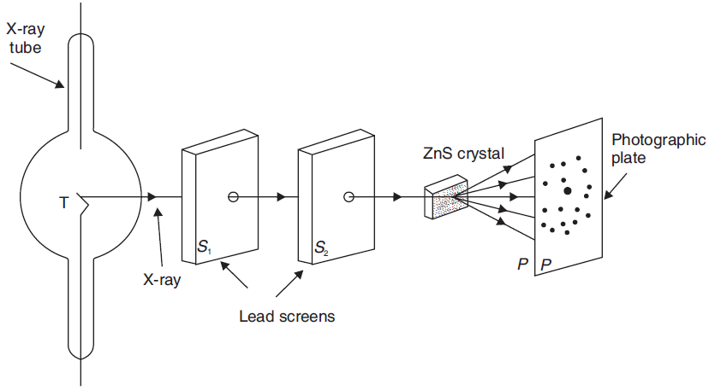
LAUE’S EXPERIMENTAL DEMONSTRATION
Laue obtained diffraction pattern of X-rays passing through a three-dimensional
crystal grating. The experimental arrangement of Laue’s demonstration is shown in figure.
Fig 2: Laue’s Experiment

Slide 22
Diffraction pattern is obtained at photographic plate. This pattern consists
of a central spot, surrounded by a series of fainter spots in a definite pattern.
The symmetrical pattern of spots is called Laue’s pattern or Laue’s spots.
Laue’s spots prove that X-rays are electromagnetic waves.
Laue’s experiment established the following two important facts:
(i) X-rays are electromagnetic waves of short wavelength.
(ii) In crystals, atoms are arranged in a three-dimensional lattice.

Slide 23
BRAGG’S LAW
Bragg considered that a crystal is made up of a number of parallel planes on which atoms are arranged in a regular fashion.
When X-rays are allowed to fall on the crystal, reflections from different planes take place. These reflected rays interfere and produce diffraction pattern.
Let us consider a narrow beam of X-rays of wavelength λ. It is allowed to incident on a crystal of parallel lattice planes having inter-atomic (lattice planes) separation of d. Let us assume the glancing angle to be θ.

Slide 24
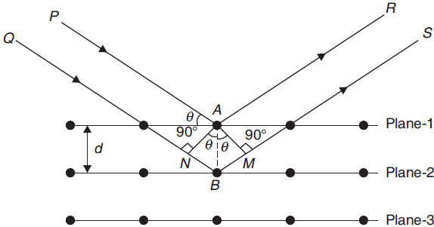
It is known that incident rays are reflected from various parallel planes of atoms in the crystal.
The diffraction pattern of reflected radiation is observed only when reflections from various planes of atoms interfere constructively.

Slide 25
Let us suppose that ray PA is reflected from atom A in the direction AR and ray QB is reflected from atom B in the direction BS.
If the path difference between AR and BS satisfies the condition of constructive interference, then a diffraction pattern will be observed.
The path difference between the reflected rays AR and BS can be given as (NB + BM).
From the fig. NB = BM = d sin θ
Hence, the path difference can be given as
(NB + BM) = 2d sin θ
If this path difference is an even multiple of λ/2 (i.e., n λ), then the two rays will reinforce each other and produce an intense spot. Thus, the condition of reinforcement can be given as
2d sin θ = n λ
where n = 1, 2, 3, etc.
It is known as Bragg’s law.

Slide 26
BRAGG’S SPECTROMETER
For the structural studies of crystals, W.H. Bragg and his son W.L. Bragg devised a spectrometer in which a crystal is used as a reflection grating instead of a transmission grating. With the help of their spectrometer, inter atomic separation in the crystal can be calculated.
Bragg’s spectrometer consists of a source of X-rays S, slits S1 and S2, and crystal C mounted on a prism table. A round scale, consisting of two vernier scales V1 and V2 to note down the angle, is attached with the prism table. An ionization chamber is attached with the prism table, along with a galvanometer.

Slide 27
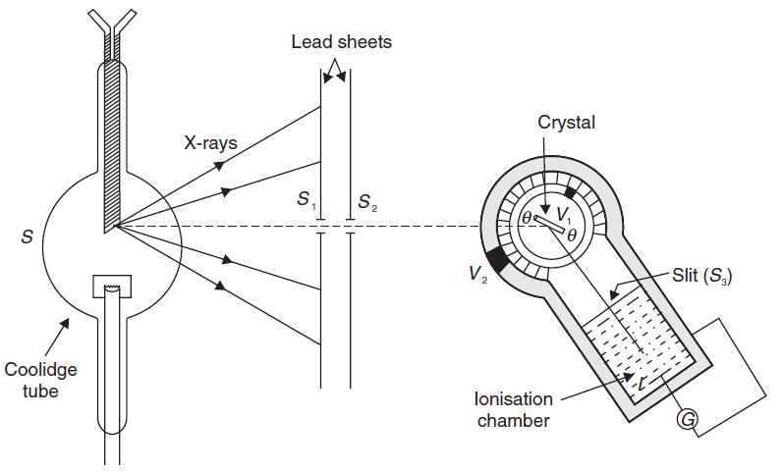
BRAGG’S SPECTROMETER
Fig. 4 Bragg’s spectrometer

Slide 28
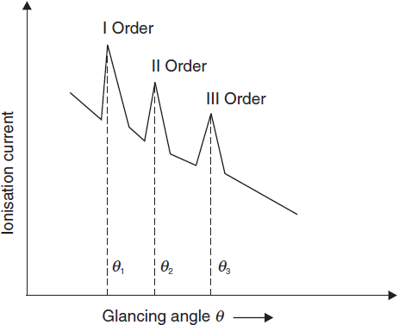
The graph plotted between the ionization current I and glancing angle θ for the NaCl crystal is shown in Figure.
The number of peaks in the curve corresponds to those glancing angles which satisfy Bragg’s equation, i.e.,
2d sin θ = n λ

Slide 29
From the experimental observations, the following facts have been established:
(i) As the order of spectrum increases, the intensity of the reflected X-rays decreases.
(ii) The ionization current does not fall to zero for any value of glancing angle θ, but it does attain a maximum value for certain glancing angles.
It indicates that there is continuous spectrum over which the characteristic line spectrum is superimposed.

